Slide 1
IMAGE-TO-IMAGE APPLICATIONS OF PIX2PIX
AND CYCLEGAN
Prepared for:
CSE 728 Group Presentation
Karan Lalwani
Yuan Hui

Slide 2


What is Image-to-Image
Input Image
New Image
Transformation
Domain X
Domain Y
Notes:
Many problems in computer vision can be posed as “translating” an input image to its corresponding output image.

Slide 3
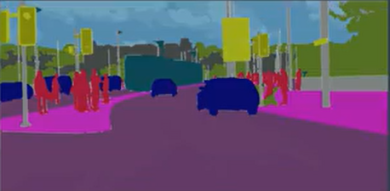
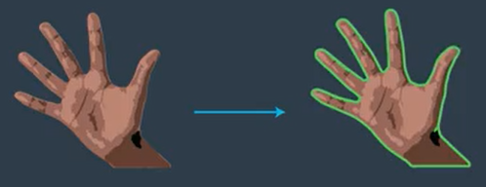
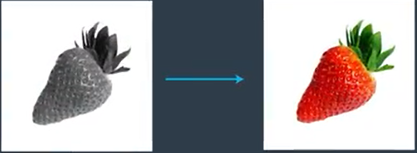
General Applications of Image-to-Image
Semantic Segmentation
Edge Detection
Computer Graphics
(Automatic Colorization)
Notes:
Segmentation - It is a task of classifying an image at pixel level
Edge Detection - Sobel, Canny
Computer Graphics (Automatic colorization) - Converting B&W image to color image

Slide 4
Models
Pix2Pix
CycleGAN

Slide 5
PIX2PIX
Applications
Model History/Related Works
Model Architecture and Algorithms
Code Demo

Slide 6
Introduction
General purpose Image to Image translation method.
Translate images in one domain x to another domain y.
It builds on cGAN architecture
Need paired images for training.
Notes:
Traditionally all the image translation tasks have been tackled with special purpose models. Say for instance semantic segmentation we need FCN or deeplab architecture but we can’t use that architecture for, say converting a black and white image to color image.
Pix to Pix General purpose - So it makes it possible to apply the same generic approach to all the problems that would otherwise require different models.
cGAN is particularly suitable for image to image translation because we can condition on an input image to get the corresponding output image
To use pix to pix model you must have pair images.

Slide 7
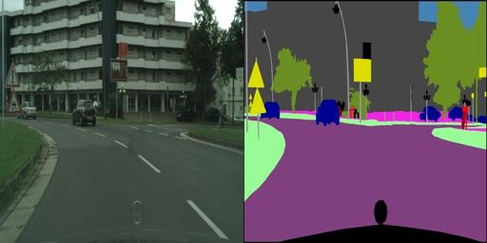
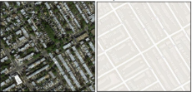
Applications
Labels
Street View
Satellite View
Digital Map

Slide 8
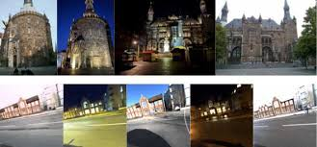
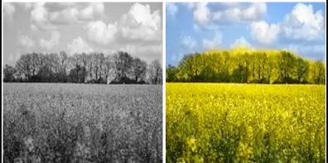
Applications
Day
Night
B&W
Color

Slide 9
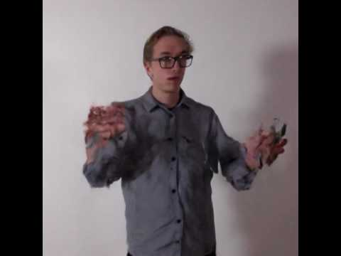
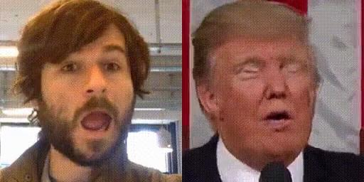
Applications
Person To Person Translation
https://affinelayer.com/pixsrv/

Slide 10
Related Works
Structured Losses for image Modeling
Conditional GANs

Slide 11
Structured Losses for Image Modeling
Unstructured Loss
Considers each output pixel conditionally independent of each other.
Can lead to blurry image.
L1(MAE), L2(MSE), Cross-entropy
Structured Loss
It penalizes the joint configuration of output.
Conditional Random Field, cGAN loss

Slide 12
Conditional GANs
GANs can generate random sharp realistic images from the data distribution but there is no control on modes of the data being generated.
cGAN addresses this problem by conditioning the model on additional information.
G : {x, z} y
In cGAN the generator learns mapping from a random noise vector z conditioned on x to produce an output y.

Slide 13
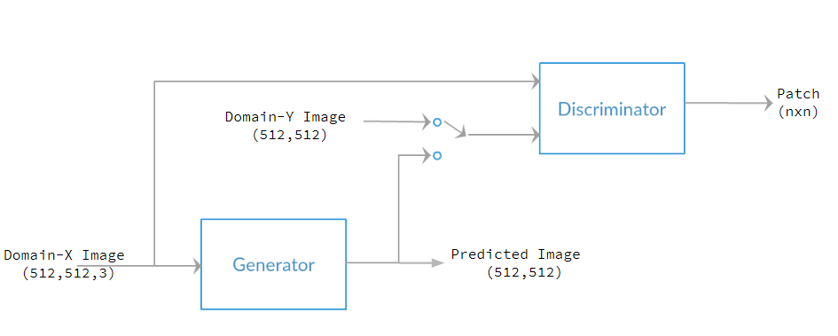
Pix-To-Pix Model Architecture

Slide 14
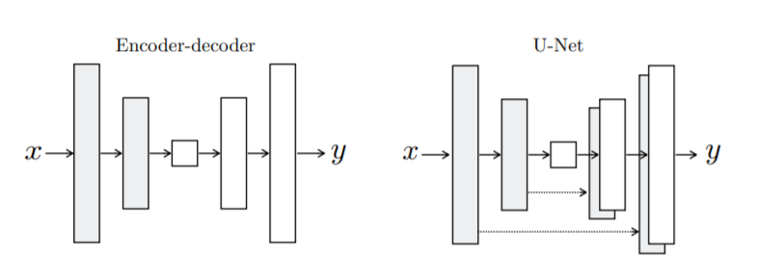
Generator
https://www.mdpi.com/2072-4292/11/11/1262/htm

Slide 15
U-Net
U-Net architecture consist of three parts
Downsampling
Conv Layer Activation Dropout Max-pool BatchNorm
Up-sampling
Convolution Transpose (type of non-linear up-sampling)
Skip Connection
Reduce coarseness and improve scale of detail in the output image.
To deal with vanishing gradient problem

Slide 16
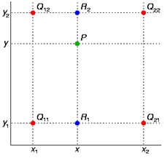
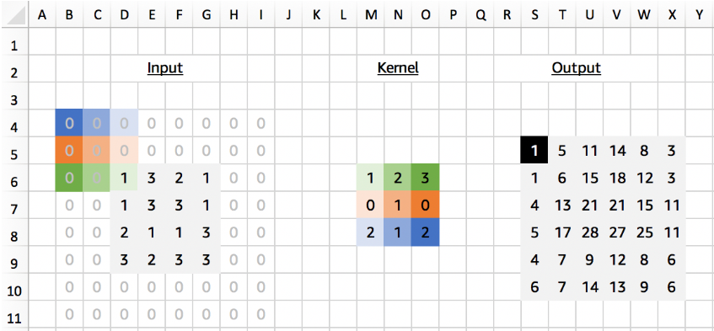
Types of Upsampling

Slide 17
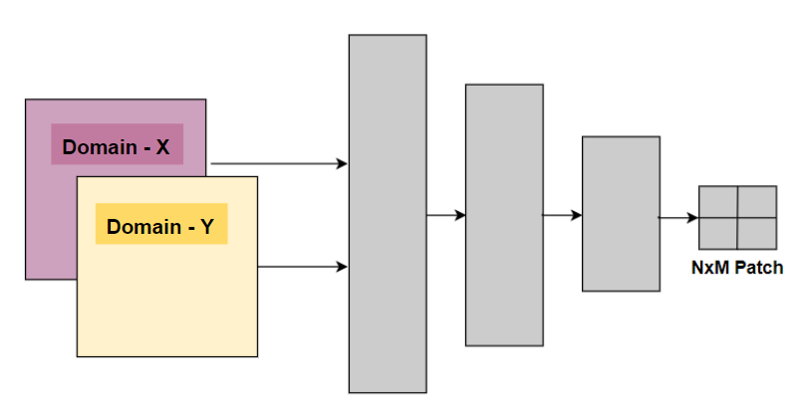
Discriminator

Slide 18
Markovian Discriminator (PatchGAN)
A "PatchGAN" is a convolutional network similar to a regular discriminator.
PatchGAN vs Regular Discriminator
Regular GAN maps a single scalar output, which signifies "In Class" or "Out Class", from an input image.
PatchGAN outputs an NxN array, where each x_{ij} signifies whether the patch_{ij} in the image is real or fake.
patch_size(receptive_field) of a layer = (output_size - 1)*stride + kernel size

Slide 19
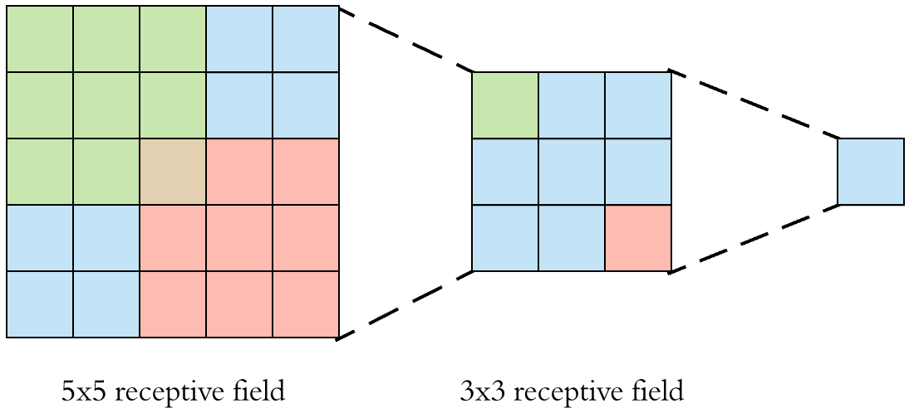
Receptive Field

Slide 20
Algorithm
Generator takes in a minibatch of Domain-X images.
Generator then converts the images into another domain Y and sends it to the discriminator.
Discriminator alternately takes In Class images and Predicted images conditioned on the respective input images and outputs an NxM patch.
Each cell of the patch indicates a probability corresponding to a region in segmented image.

Slide 21
Pix-To-Pix Model Architecture

Slide 22
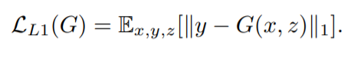
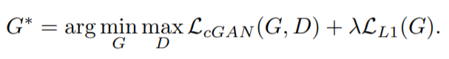
Loss Function

Slide 23
Evaluation
Amazon Mechanical Turk
Turkers were given feedback on first 10 images.
Tested them on 40 images.
Map to Aerial - Fooled participants on 18.9% trials.
Aerial to Map - Fooled participants on 6.1% trials.
Grey to Color - Fooled participants on 22.5% trials.
FCN score
If the images are realistic the classifier can synthesize the image correctly
Used FCN-8
Notes:
27.8% for colorful image colorization.

Slide 24
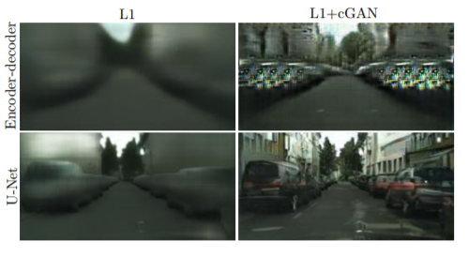
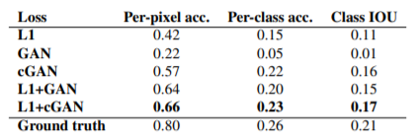
Experimentation - Skip Connections

Slide 25
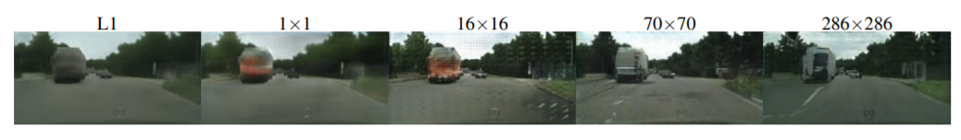
Experimentation - Size of Patch
16x16 | Good Score but tiling effects
70x70 | Lessens the tiling effect and achieves slightly better scores
286x286 | Lower FCN score

Slide 26
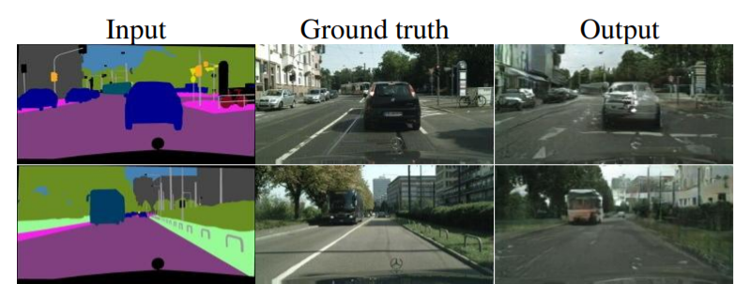
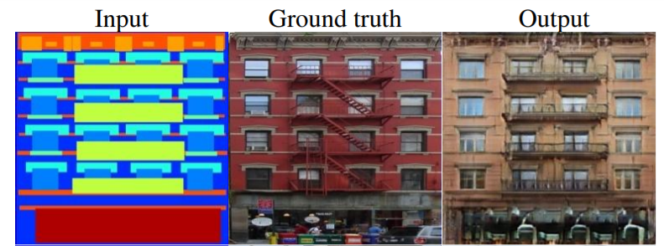
Results

Slide 27
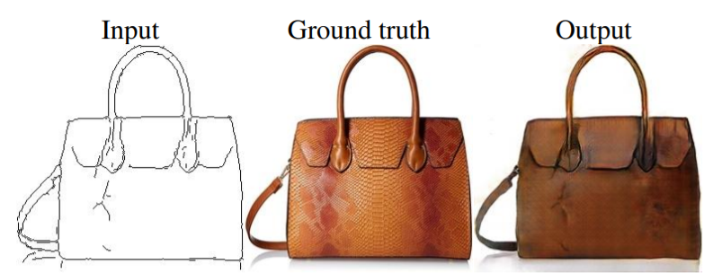
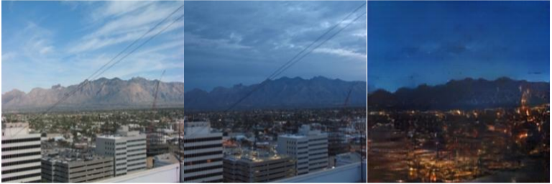
Results

Slide 28
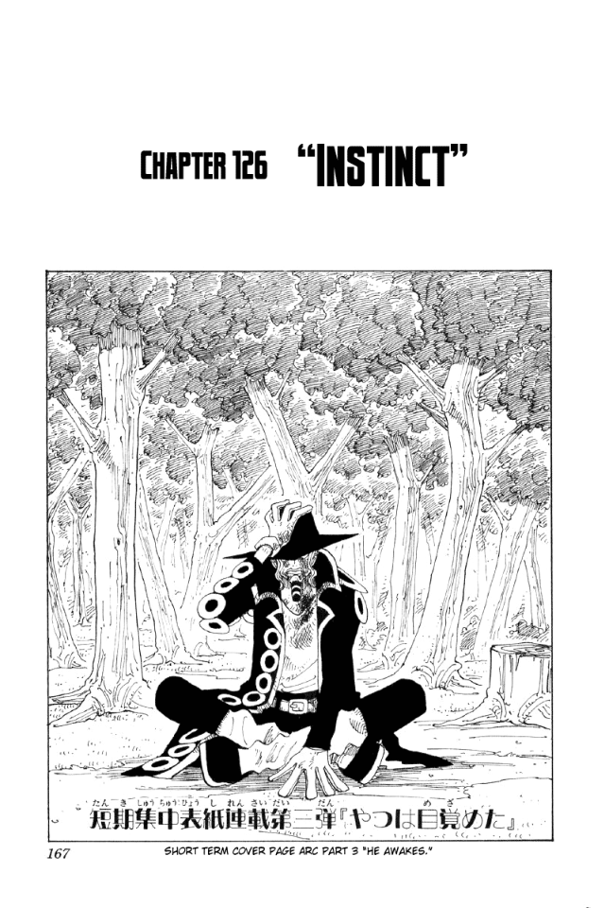
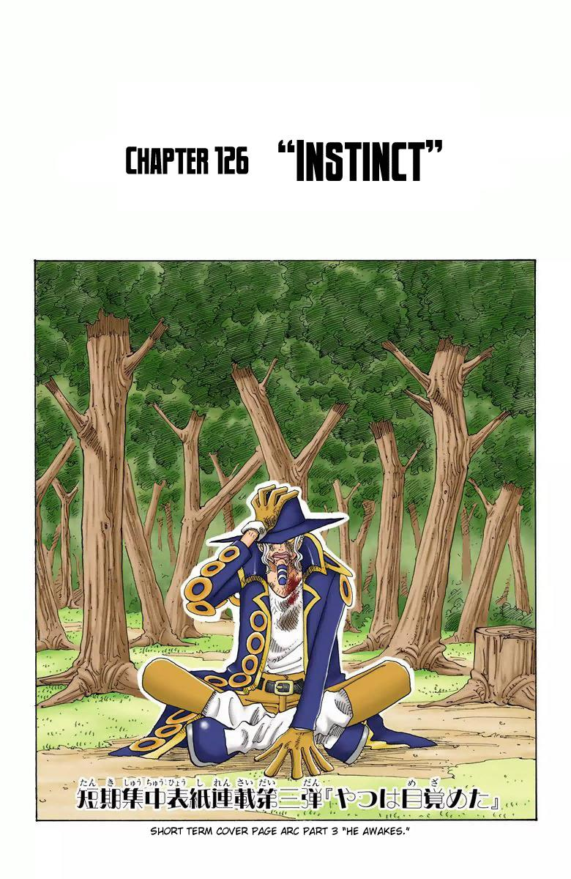
Code Demo
Comic Colorization
https://colab.research.google.com/drive/14eaxEcow9pj5Dp7pgXo9C5BzwdMGdkjK
Comic Colorization
using
PixToPix

Slide 29
Reference
Original Paper - https://arxiv.org/abs/1611.07004
PixtoPix website - https://affinelayer.com/pixsrv/
Youtube Video - https://www.youtube.com/watch?v=nUMdCBwsrtQ
Tweet - https://twitter.com/genekogan/status/857922705412239362?s=20
Transpose Convolution image- https://medium.com/apache-mxnet/transposed-convolutions-explained-with-ms-excel-52d13030c7e8
Bilinear Interpolation - http://supercomputingblog.com/graphics/coding-bilinear-interpolation/
Amazon Mechanical Turk - https://www.mturk.com/
Other Applications of PixToPix - https://ml4a.github.io/guides/Pix2Pix/

Slide 30
THANK YOU FOR YOUR ATTENTION!
Q & A!

